Slide 1
Eye-tracking demonstrates the attention paid to newspaper print ads

Slide 2
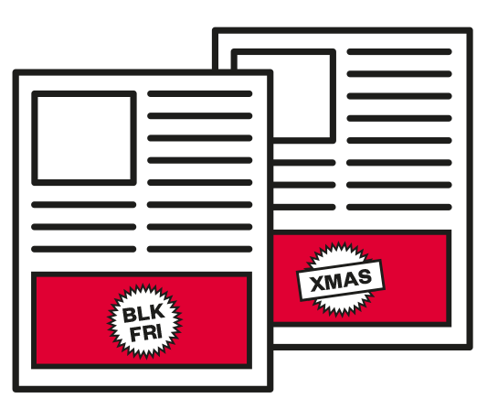
Print newsbrands deliver high standout and dwell time
75% of readers look at each print ad on average
Print newsbrand ads are viewed for 2 ½ times longer than an average digital ad
Larger sizes, special formats and multiple ads per issue increase impact and dwell times
Standout increases for Black Friday event (84%) and Christmas period (86%)
Dwell times also increase:
Black Friday average 2.3”, Christmas average 2.6”
Best performing seasonal ads attract 100% attention for an average of 4-6 seconds
Newsbrands = theguardian.com, telegraph.co.uk, independent.co.uk, indy100.independent.co.uk, thetimes.co.uk, ft.com, dailymail.co.uk, mirror.co.uk, standard.co.uk, thesun.co.uk, dailystar.co.uk, metro.co.uk, express.co.uk, manchestereveningnews.co.uk, walesonline.co.uk, dailyrecord.co.uk. Others = msn.com, uk.yahoo.com, digitalspy.com, engadget.com, mashable.com, ibtimes.co.uk, thisismoney.co.uk, bleacherreport.com, pistonheads.com, weather.com, howtogeek.com, theregister.co.uk, sportinglife.com, channel4.com, itv.com, channel5.com, marieclaire.co.uk, timeout.com, trustedreviews.com, goodtoknow.co.uk, bbcgoodfood.com, pcadvisor.co.uk, nme.com, autoexpress.co.uk, forbes.com, radiotimes.com

Slide 3
Print advertising commands significantly longer dwell times than digital
Average dwell time with print advertising = 2.2”
Average dwell time with non-newsbrand digital advertising = 0.9”
Digital display = average across non newsbrand sites. Digital newsbrands have 30% longer ad dwell times

Slide 4
Standout and dwell time differs by format in print newsbrands
Larger formats work harder at grabbing and keeping attention
Full page ads generate 1.5x dwell time as 10x7 ads
(seconds)
Full page
25x4
17x7
10x7

Slide 5
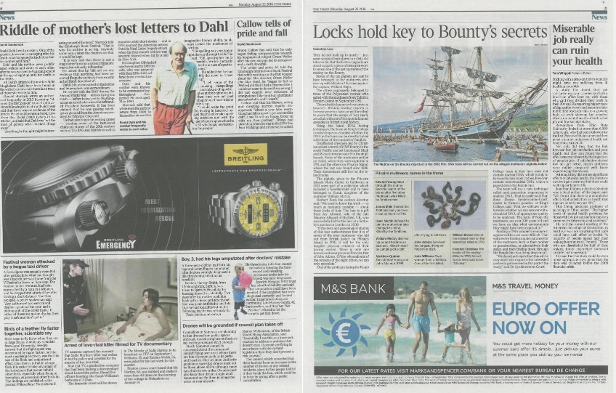
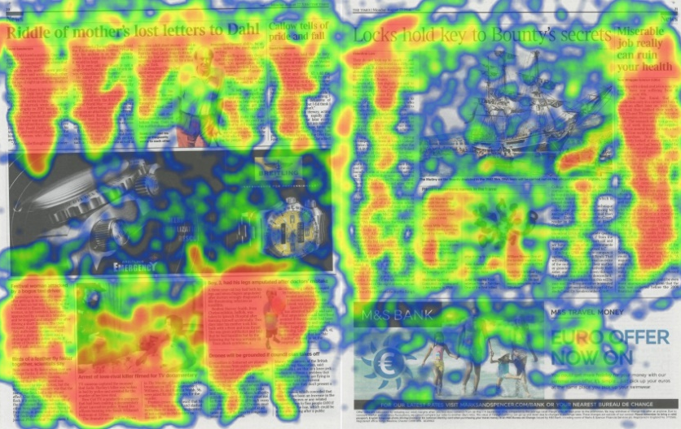
Special formats draw attention in print newsbrands
Being inline with editorial can lead to greater attention and dwell time
Significant uplifts in attention for innovative formats in other contexts (disruptive ads, ‘Battenberg 17x7s’, etc.), which can outperform full page ads
93%
2.2”
81%
1.5”

Slide 6
Multiple ads generate aggregated attention
Multiple ads throughout the paper can deliver significantly higher attention levels - 26% of respondents looked at Curry’s PC World branded ads for over 10 seconds.
% viewing for each ad

Slide 7
Readers study Black Friday ads in print newsbrands more closely
Black Friday event boosts time spent on ads in print newsbrands by 39%
Readership per day
Av. time spent on all ads per visitor per day
Total time on ads across all publications per day (hours)
Black Friday uplift
13,784,649
53.7 secs
205,663 hours
Normal
+39%
Print
13,784,649
74.4 secs
284,958 hours
Black Friday
Readership per day figures from NRS Average time spent on all ads per visitor per day on a normal day is estimated using Lumen’s econometric model

Slide 8
Black Friday themed ads achieve higher standout and dwell time
All print newsbrand ads standout more strongly during Black Friday period, but Black Friday themed ads are noticed more
Black Friday themed ads also achieve 13% higher dwell time than non Black Friday ads in the same paper
All ads av. standout | 75%
Standout
Dwell time

Slide 9
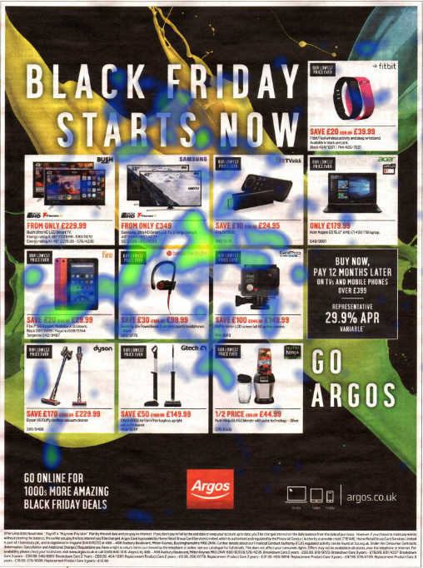
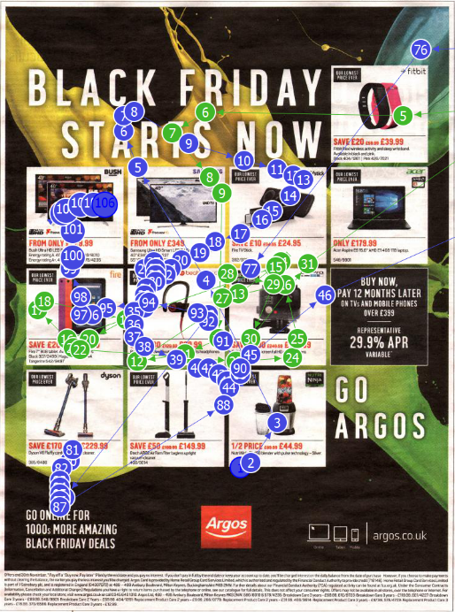
“Catalogue” approach works for Black Friday
Heat map
Pathway
Standout | 90%
Av. dwell time | 5.5”
All ads av. standout | 75%
Full page – 23/11/2016
‘Time spent norm’ = average for combination of format, page number, category of ad (e.g food retail) and publication.
‘Standout’ = % of readers with at least one fixation on ad (where one fixation is 1/30th of a second).

Slide 10
Print newsbrands drive intention to purchase
Are you likely to buy a deal on Black Friday?
Having read the paper, did any of the advertisements make you more likely to buy a deal on Black Friday?

Slide 11
Newsbrand print ads draw more attention at Christmas
Christmas period increases time spent on print newsbrand ads by 37%
Readership per day
Av. time spent on all ads per visitor per day
Total time on ads across all publications per day (hours)
Christmas uplift
13,474,894
75.35 secs
282,041 hours
Normal
+37%
Print
13,474,894
103.05 secs
385,725 hours
Christmas
Readership per day figures from NRS Average time spent on all ads per visitor per day on a normal day is estimated using Lumen’s econometric model

Slide 12
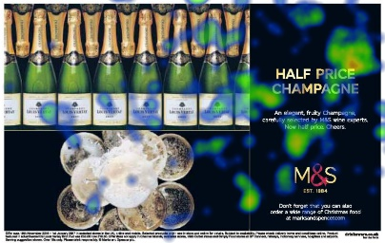
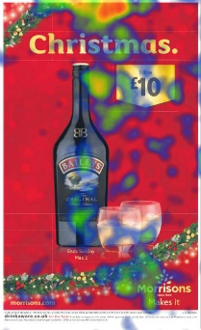
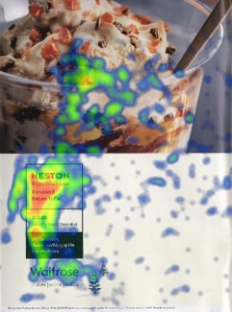
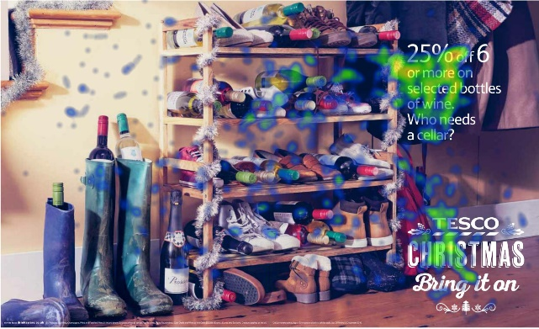
Christmas retail ads grab attention in print newsbrands
M&S 17x7
Standout: 100%
Dwell time: 2.6”
Tesco DPS
Standout: 100%
Dwell time: 4.5”
Waitrose wrap page 1 Standout: 100%
Dwell time: 6.9”
Morrisons 25x4
Standout: 94%
Dwell time: 2.2”
All ads av. standout | 75%
While all dwell times exceed norms, simpler creative generates more focussed attention, so do not require long dwell times to be effective

Slide 13
Christmas period ads benefit from festive theme
All print newsbrand ads standout more strongly during Christmas period, but Christmassy ads are noticed more
Christmas themed ads also achieve 18% higher dwell time than non Christmas ads in the same paper
2.6”
2.2”
All ads av. standout | 75%
Standout
Dwell time

